Slide 1

What the heck is git?

Slide 2
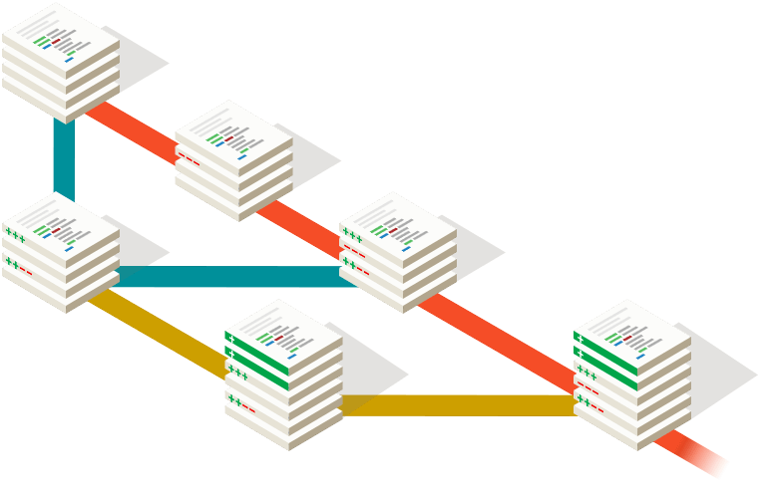
Basically…
Git lets you create snapshots of your code. These snapshots then show a history of the changes to your code over time.

Slide 3
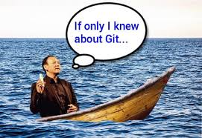
Why use it?
See the changes to your code over time
Prove against plagiarism
No more irreversible changes
Group projects aren’t quite as bad
It is used in the working world

Slide 4
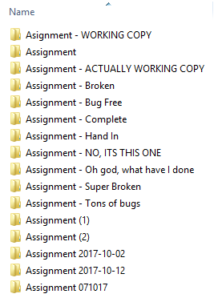
Most importantly… None of this!

Slide 5
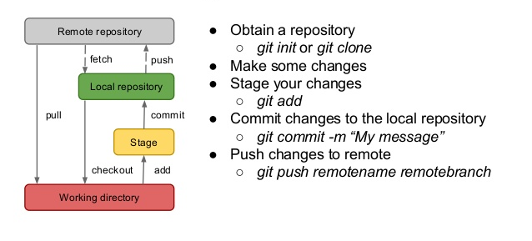
How does it work?

Slide 6

More details?
*Nerd voice*
Git is a version control system that allows cheap and easy local branching to provide non-linear development. As well, online git repos allows for multiple workflows where people can work together with great efficiency!
*End nerd voice*

Slide 7
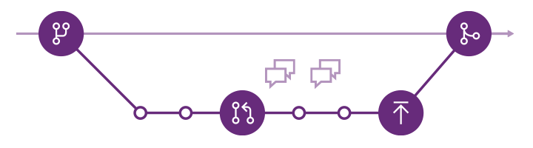
Woah there, break that down for me
Version Control System
Tracks changes to your code, and allows you to undo and reapply those changes.
Branching
Have multiple versions of your code at the same time, and switch between them easily.

Slide 8
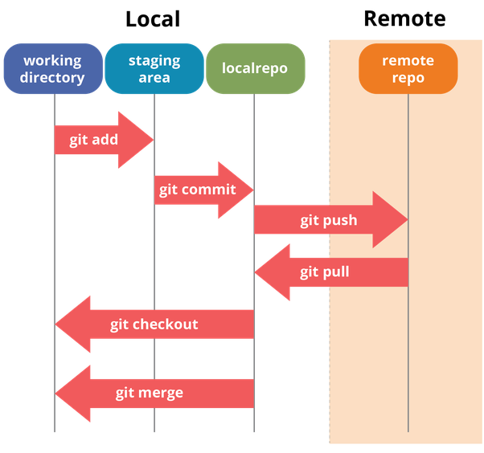
More breakdown
Git repo
A project using git is called a “Git Repository”, or “Git repo” for short.
Multiple Workflows
By hosting your git repo online, multiple people can work on the same code at the same time.

Slide 9
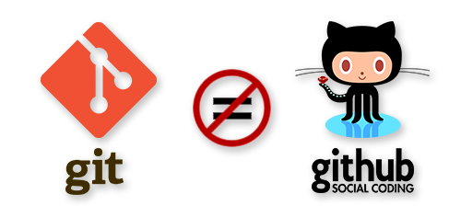
Are git and github the same thing?

Slide 10
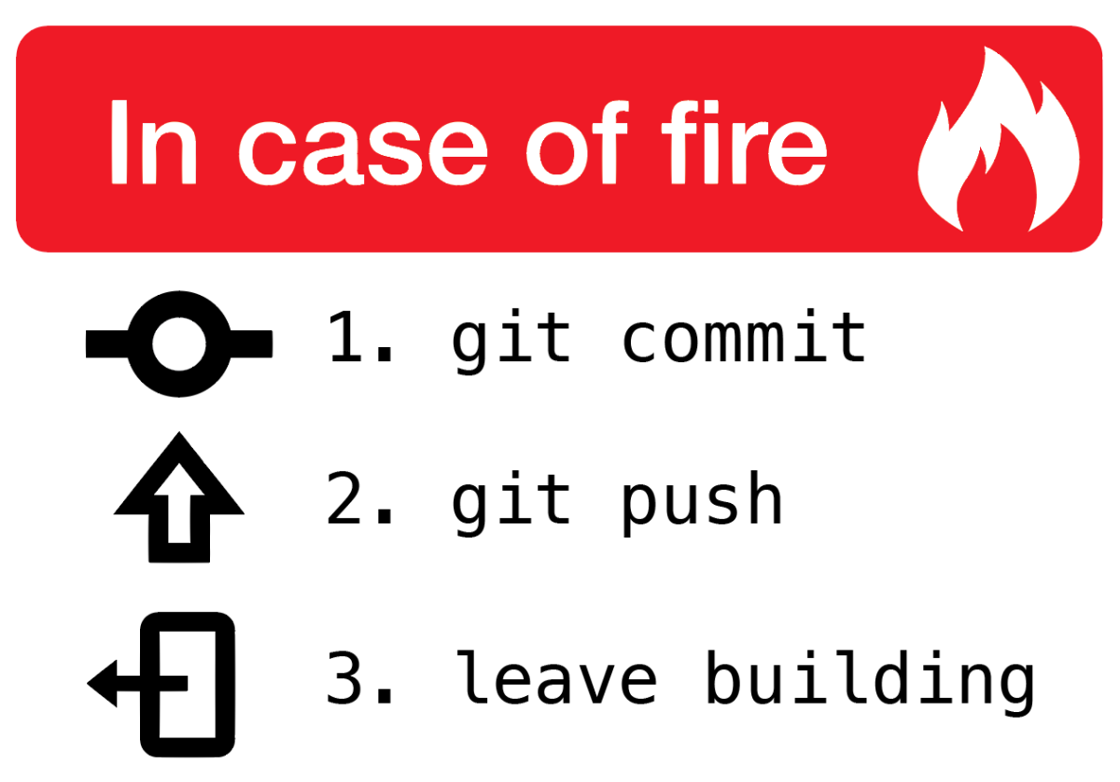
So, what is github?
Github is an online platform for you to store your git repositories.
This allows you to:
Work on your code in different places
Showcase your code online
Allow other people to easily contribute to your code.

Slide 11
Gitting started
Install git: https://git-scm.com/downloads
Open terminal*
Go to a folder with code
git init
git add --all
git commit -m “Initial Commit”
* You may have to add git to your path in order to use it

Slide 12
Woah, command line? No thanks.
You’re not alone! Luckily, there are GUIs available for git. Such as GitKraken. This makes it easier to learn about git without having to learn how to use the command line.

Slide 13
Let’s get started!

